Slide 1

Welcome to class 4A3!
Teacher: Nguyen Thi Thuy
Vu Xuan Thieu Primary School

Slide 2
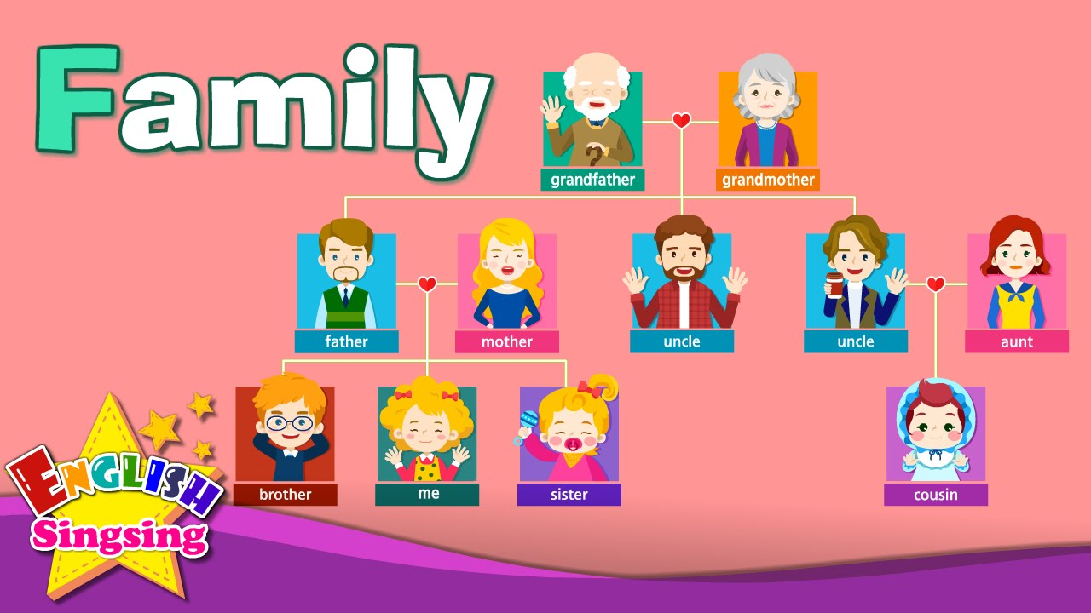
Warm up
?
grandfather
grandmother
father
mother
uncle
uncle
aunt
brother
me
sister
cousin

Slide 3
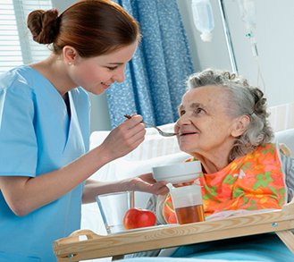
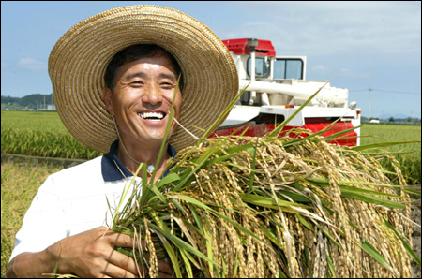
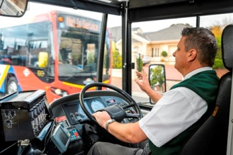

1. New words:
a farmer
a nurse
a driver
a doctor

Slide 4



a factory worker
a teacher
a student

Slide 5
1.New words:
- A farmer: nông dân
A nurse: y tá
A driver: người lái xe
A doctor: bác sĩ
A factory worker: công nhân
A teacher: giáo viên
A student: học sinh, sinh viên
jobs

Slide 6


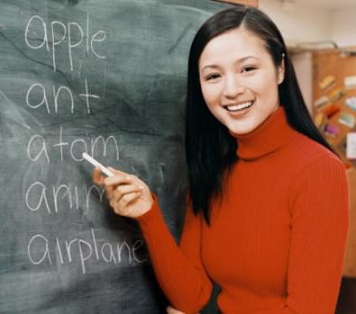
Game: Find the jobs
a student
a teacher

Slide 7


a doctor
a nurse

Slide 8
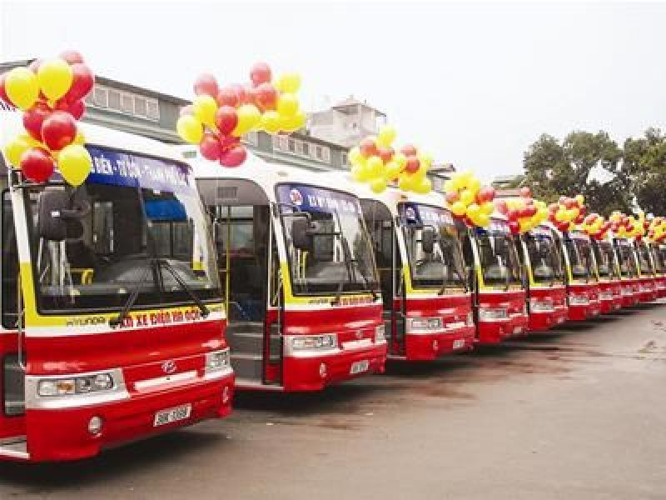
a driver

Slide 9
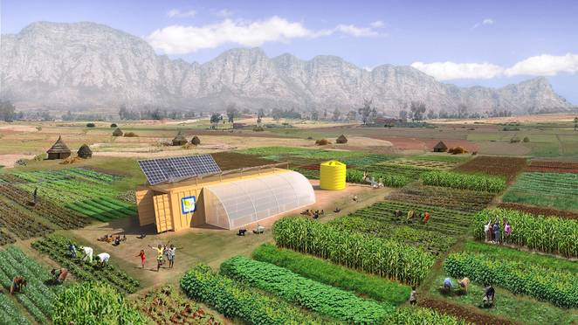
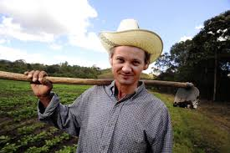


Slide 10
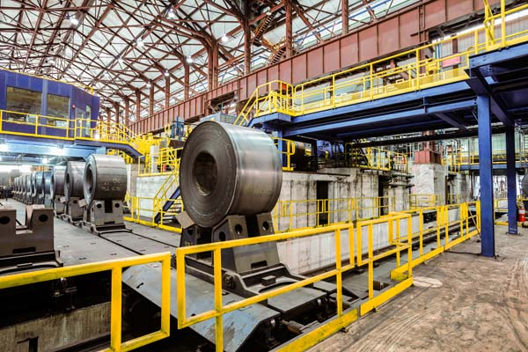
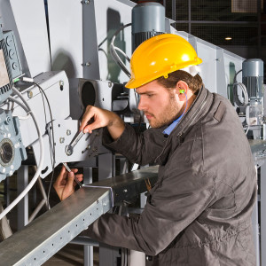


Slide 11
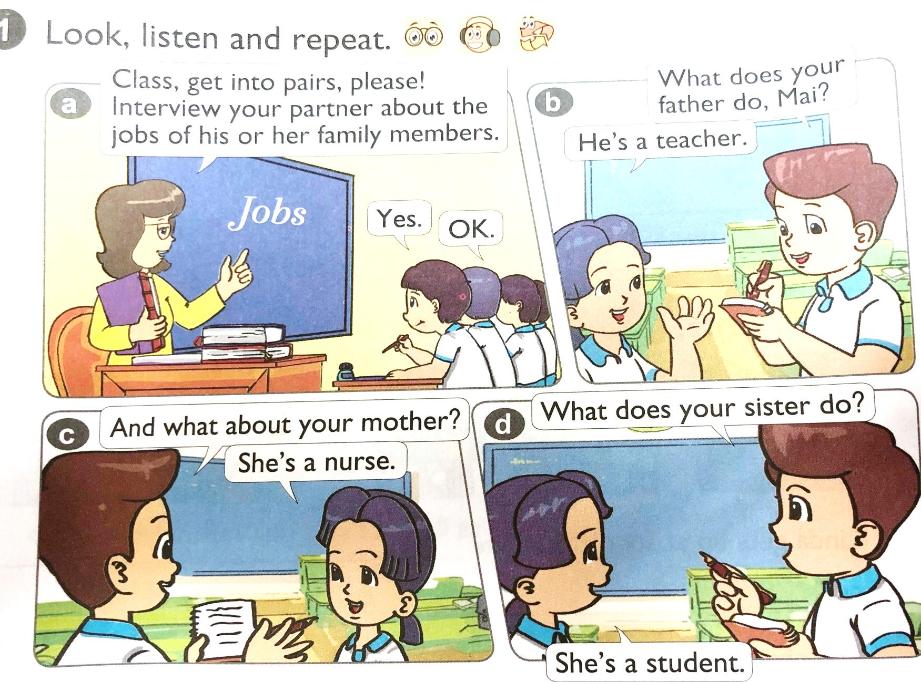


Slide 12
2.Model sentences:
A: What does your father do?
mother
B: He’s a teacher.
She’s a nurse.

Slide 13
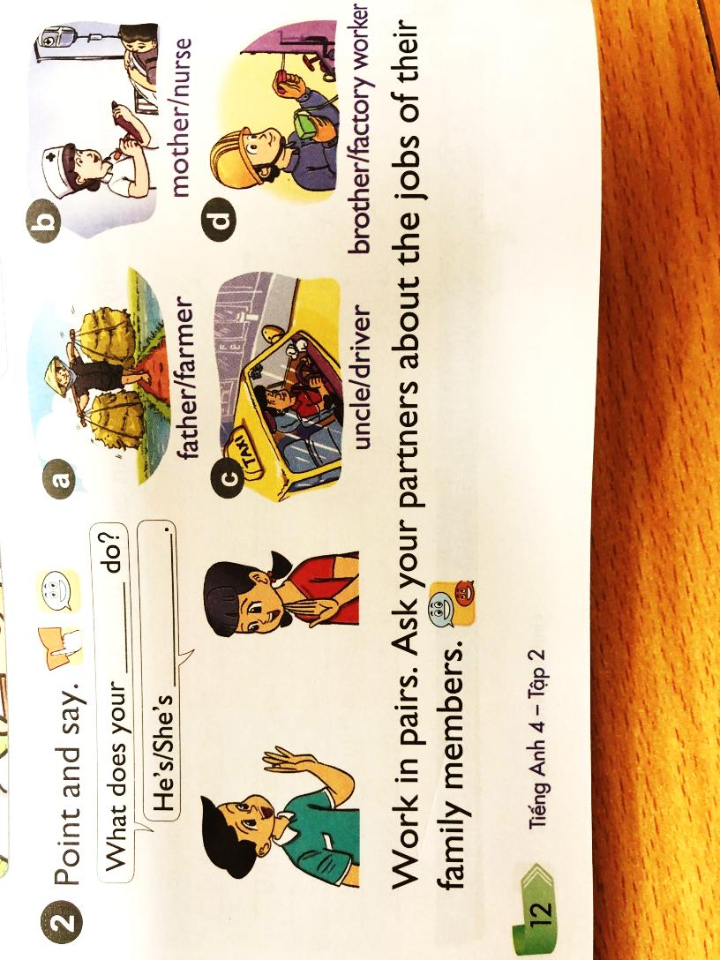

Slide 14
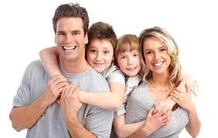

Work in pairs. Ask your partners about the jobs of their family members.

Slide 15
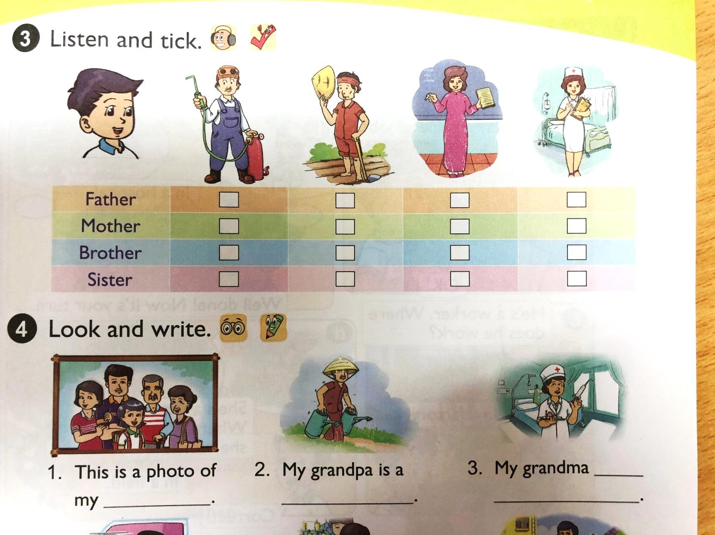
√
√
√

Slide 16
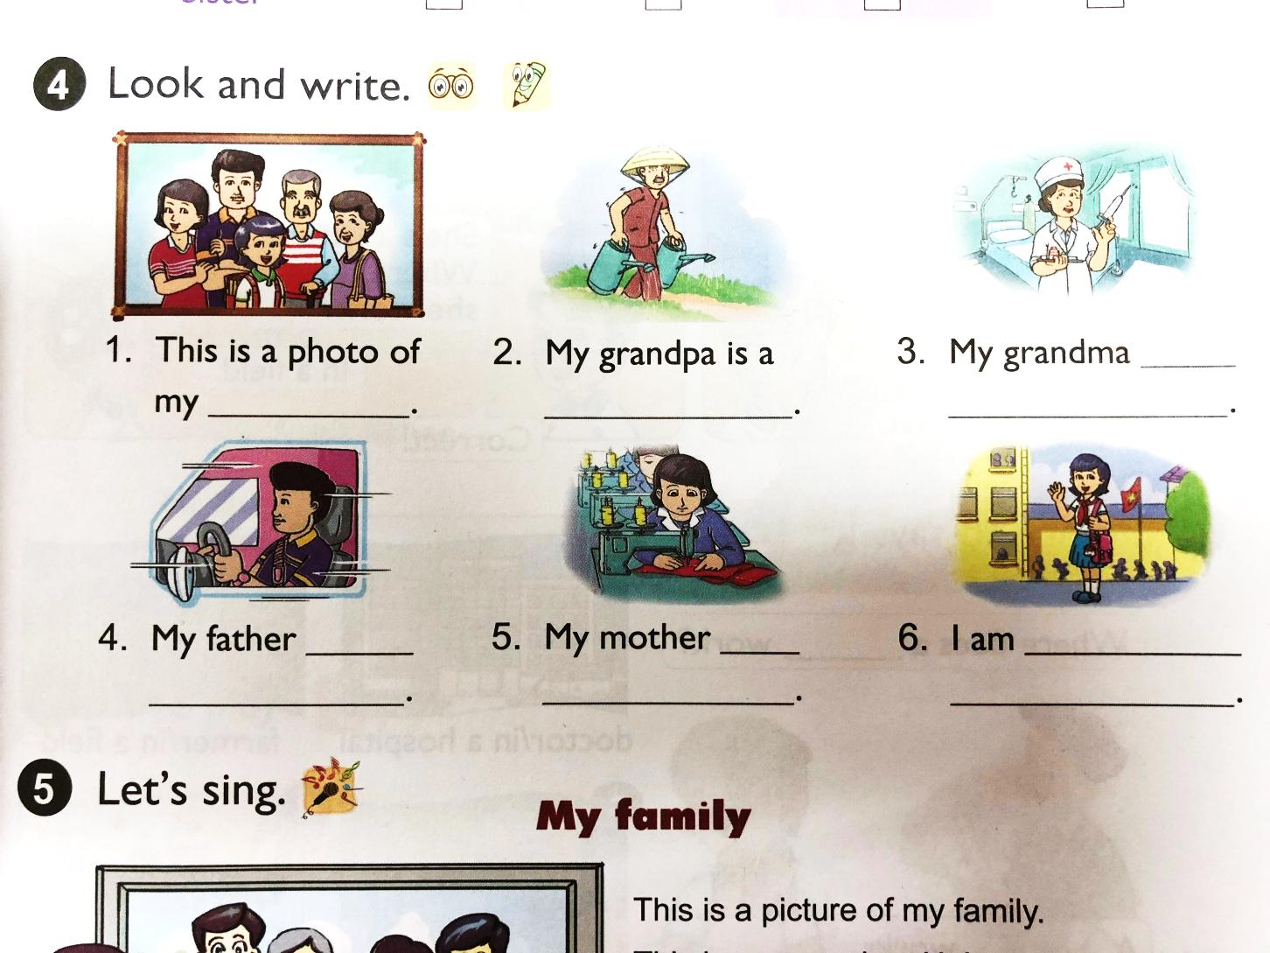
family
farmer
is a nurse
is a driver
is a worker
a student

Slide 17


